Slide 1

BASIC ECONOMIC PROBLEM: POVERTY
Name : Arshad Muthalif
Enno: 160410116007
Dept: IT-1

Slide 2
Contents:
Introduction to economic problems
Intro to poverty
Meaning of poverty
Absolute and relative poverty
Cause of poverty
Measures to reduce poverty
Case study on poverty

Slide 3
Intro to economic problems
It assumes that human wants are unlimited, but the means to satisfy human wants are scarce.
The economic problem is most simply explained by the question: "How do we satisfy unlimited wants with limited resources?“
Currently govt of india faces the following three economic problems:
1)poverty
2)unemployement
3) inflation

Slide 4
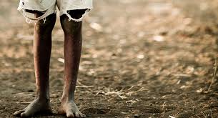
Intro to poverty
Poverty is the most crucial economic problem of any society.
Poverty indicates the avilabilty of income even to maintain the subsistence level of basic needs like food, shelter, and clothing.
Poverty differs from country to country.

Slide 5
Meaning of poverty
The term poverty is a socio – economic state which indicates that a section of the society is unable to fulfil even the basic necessity of life, like food, shelter and clothing.
The united nation’s has defined the poverty as under: “poverty is fundamentally a denial of choice and oppurtunities and a violation of human dignity. It means lack of basic capacity to participate effectively in society.

Slide 6
Absolute and relative poverty
Absolut poverty : it indicates the lack of sufficient food, clean drinking water, reasonable clothing and appropriate housing for shelter irrespective of any other consideration.
Relative poverty: it is considered in terms of the variations in the standard of living that prevails in different countries. The absolute poverty differs from country to country.

Slide 7
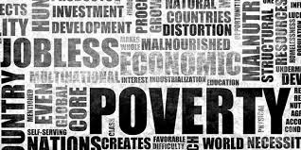
Causes of poverty
1. Rapidly Rising Population:
2. Low Productivity in Agriculture:
3. Under Utilized Resources:
4. Low Rate of Economic Development:
5. Price Rise:
7. Unemployment:

Slide 8
Measures to reduce poverty
Agricultural Growth and Poverty Alleviation
Speedy Development of Infrastructure
Accelerating Human Resource Development
Public Distribution System (PDS)
Direct Attack on Poverty: Special Employment Schemes for the Poor

Slide 9
Case study on poverty
Poverty in India is caused by a number of factors. India was already in a weak state after becoming independent from Britain. However, overpopulation tends to be the leading reason.
As there are poor employment opportunities in villages, people moved to cities, leading to crowded streets and unhealthy living conditions. Also, the belief of inferiority of women brought about the penury that Indians suffer from.

Slide 10
The caste system also plays a role in poverty-those in the lower classes are deprived of various opportunities. Because of this, more than 40% of India’s population is illiterate.
Those living in rural areas depend on agriculture, which is dependent on rain patterns and the monsoon season. If there happens to be inadequate rain or monsoon failure, crops cease to grow, leading to a number of starving people.

Slide 11
There are certain initiatives aimed at poverty reduction in India. Thus, in 2011, the number of the poor was almost 8% down as compared with 2009.
in India, around 50% lack proper accommodation, 35% of the country’s households lack clean water supplies, and 70% of the entire population live in the anti-sanitary conditions.

Slide 12
At the same time, there are evident problems with schooling (85% rural locations do not have a school), infrastructure, and child labour.
GOONJ:
Goonj is a non-governmental organisation headquartered in Delhi, India which undertakes disaster relief, humanitarian aid and community development in parts of 22 states across India. Goonj is the first to highlight clothing as a basic but unaddressed need which deserves a place on the development agenda.

Slide 13
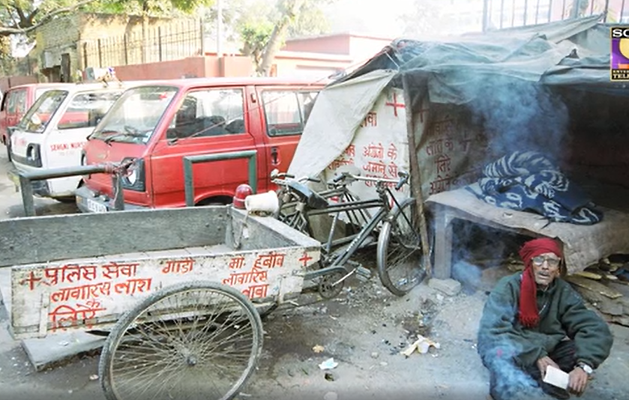

Slide 14
GOONJ is turning the discarded and under utilised material of cities into a tool to address ignored basic needs and development issues of rural India. Goonj’s work is not about collecting and distributing material but about changing the age old tradition of giving old material as charity and repositioning it into regular and dignified giving.
At GOONJ the focus is on these needles. With a large scale civic participation it is not only becoming a big people’s movement for development but is also creating a parallel economy where every work doesn’t have to wait for money; huge quantities of old re-usable material becomes a valuable resource.

Slide 15
Thank you

